Slide 1


A
Presentation
On
Regression Analysis Using Emerging POWER BI
Session - 2024-2025
Department of Computer Science and Engineering
Presented by-
Presented to-
Ravikesh kr Singh (2103600100075)
Mr. Kumar Bibhuti Bhusan
Aditya Gupta (2103600100008)
(Assistant Professor)
Bipin Kharwar (2103600100037)
Shubham Jaiswal (2103600100094)

Slide 2



Agenda
Introduction
Problem statement
Objective
Technology
Working
Features
conclusion
Air BNB
POWER BI

Slide 3





MEET OUR
TEAM MEMBERS
ADITYA GUPTA
2103600100008
RAVIKESH SINGH
2103600100075
BIPIN KHARWAR
2103600100037
SHUBHAM JAISWAL
2103600100094

Slide 4

Introduction
Regression Analysis Using Emerging Power BI In today's data-driven landscape, organizations are increasingly leveraging data analytics to derive actionable insights and inform strategic decisions. This project focuses on regression analysis, a powerful statistical method used to understand the relationship between dependent and independent variables. By employing various regression techniques, we aim to identify patterns, predict outcomes, and provide meaningful interpretations of the data at hand.

Slide 5

Problem Statement
In the context of our regression analysis project, the primary problem we aim to address is the challenge of accurately predicting [specific outcome or variable] based on a set of independent variables. For instance, businesses often struggle to understand how factors such as [list relevant factors, e.g., marketing spend, customer demographics, economic indicators] influence sales performance. This lack of clarity can lead to inefficient resource allocation and missed opportunities.

Slide 6

OBJECTIVE
Data Collection and Preparation
Exploratory Data Analysis (EDA)
Model Development
Interpretation of Results
Visualization

Slide 7



Methodologies
JUPYTER NOTEBOOK
STATISTICS
PYTHON LIBRARIES
PowerBI

Slide 8


ALGORITHMS
IMPLEMENTATION OF REGRESSION ANALYSIS(KNN ALGORITHM) FOR OUTLIER TREATMENT
Logistic Regression
Linear Regression
Multiple Regression
Polynomial Regression

Slide 9
EXTRAXTION & TRANSFORMATION
MISSION
1
DATA MINING USING PYTHON
USE OF REGRESSION OR CLASSIFICATION ANALYTICS FOR OUTLIER TREATMENT
2
DATA CLEANING & NULL REMOVAL
OUTLIER TREATMENT & TRANSFORMATION OF DATA
3

Slide 10
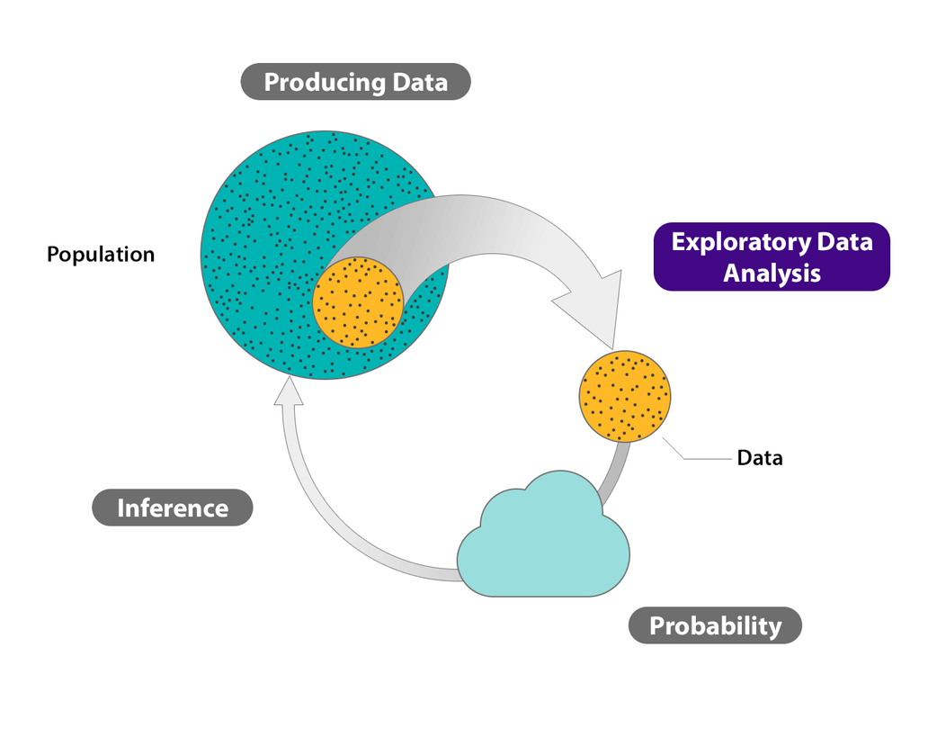
EXPLORATORY DATA
1
ANALYSIS
DATA EXTRACTION
COMPARISION ON VARIOUS FACTORS
2
COLOUMNS ARE USED FOR COMPARISION
3

Slide 11
FLOW CHART
UNDERSTANDING BUSINESS REQURIMENTS
EXTRACT TRANFORM LOAD
EXPLORATORY DATA ANALYSIS
DATA MODELING
VISUALIZATION

Slide 12



DATA VISUALIZATION
USE OF CHARTS
LIBRARIES USED: SEABORN, MATPLOTLIB
USE FOR EASE UNDERSTANDING
EXTERNAL TOOL POWER BI & MS EXCEL

Slide 13

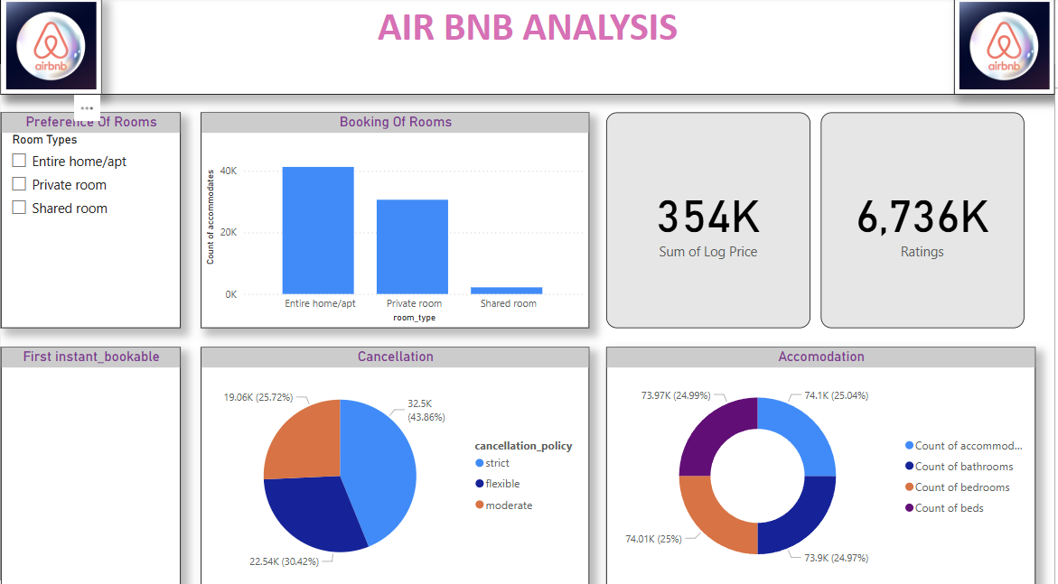


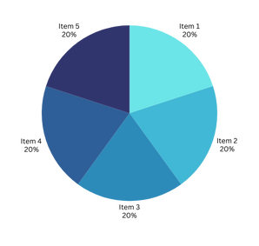
POWER BI DASHBOARD

Slide 14

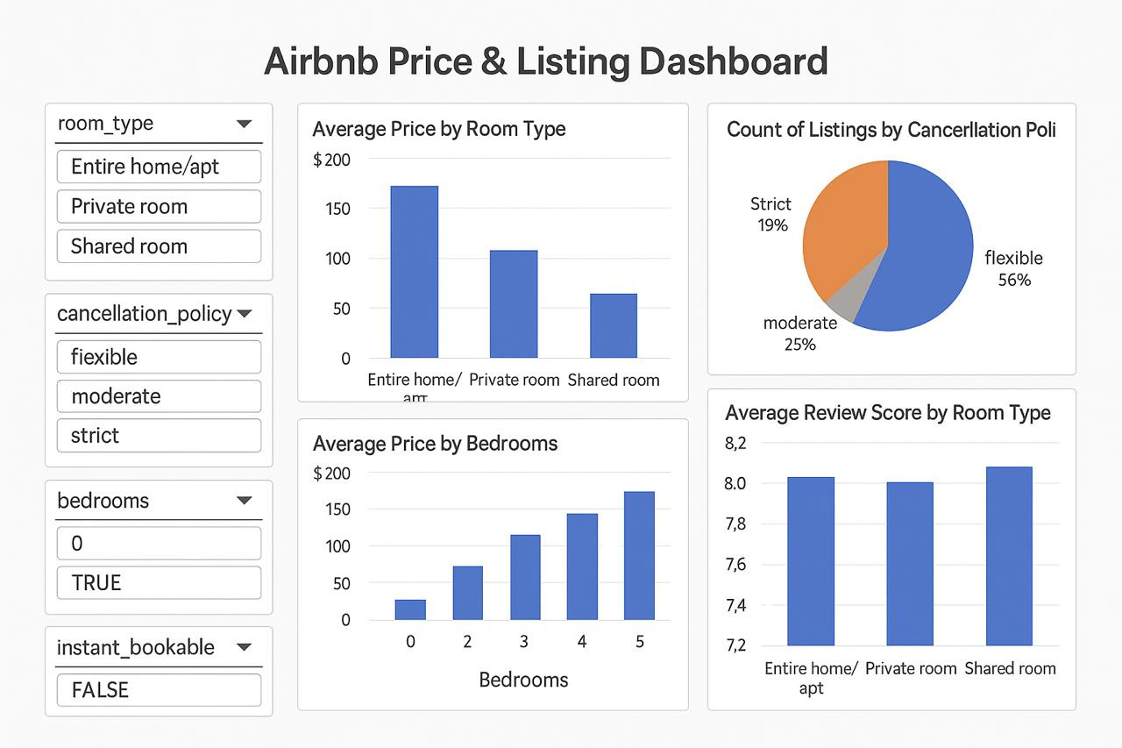
MS EXCEL PLANNING

Slide 15

THANK YOU

